Slide 1
PYTHON FOUR WAYS
CAIR 2025
A beginner’s primer to practical uses of Python in data analytics

Slide 3
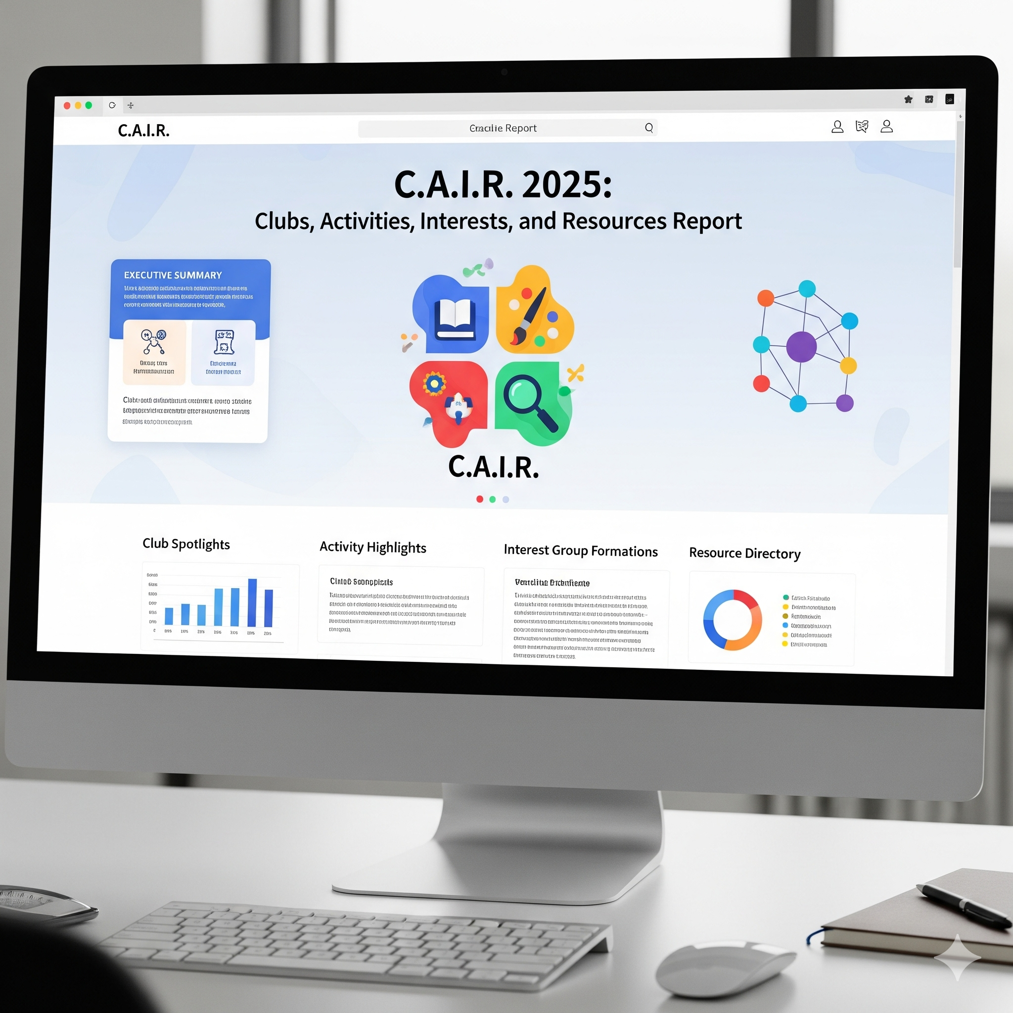
It’s that time of year again!

Slide 4
Get your data together

Slide 5
Common Errors

Slide 6
Database Matching

Slide 7
Automation

